Slide 1

Warby Parker’s Marketing Funnels
Learn SQL from Scratch
Britt Bischoff
6/18/2018

Slide 2
Example Table of Contents
Company Overview
What is the Quiz Funnel
A/B Testing with Home Try-On Funnel
Recommendations

Slide 3
1. Company Overview

Slide 4
1.1 Company Overview
Since 2010, Warby Parker has offered affordable designer eyewear while leading the way for socially conscious businesses, distributing a pair of eyeglasses to someone in need for every pair sold.
Data was collected across the company’s two funnels, their Quiz Funnel (survey), and the Home Try-On Funnel (purchase).

Slide 5
2. The Quiz Funnel

Slide 6
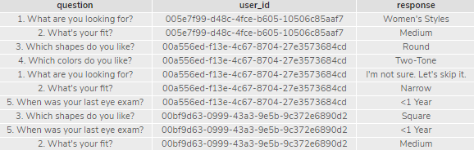
The Quiz Funnel
Warby Parker’s quiz funnel is a survey comprised of 5 questions designed to help the user determine their ideal pair of frames. Completion of this funnel is intended to push the user through the Home Try-On Funnel.
Data collected from the survey table:
Question – the question asked in the survey
User id – the user identifier
Response – the user’s answer
SELECT *
FROM survey
LIMIT 10;

Slide 7
The Quiz Funnel, Survey Interaction
The quiz funnel and sequence of steps is as follows:
Question 1: What are you looking for?
Question 2: What’s your fit?
Question 3: Which shapes do you like?
Question 4: Which colors do you like?
Question 5: When was your last eye exam?
Created this funnel by counting the number of distinct users that answered questions to this survey and grouping by the question column.
SELECT question, COUNT(DISTINCT user_id)
FROM survey
GROUP BY question;
question | COUNT(DISTINCT user_id)
1. What are you looking for? | 500
2. What's your fit? | 475
3. Which shapes do you like? | 380
4. Which colors do you like? | 361
5. When was your last eye exam? | 270

Slide 8
The Quiz Funnel, Survey Completion Rates
After analyzing if certain questions prompted users to leave the survey, it was found that questions 3 and 5 in the survey have lower completion rates, with completion rates of 80% and 74.79%, respectively.
The reason(s) questions 3 and 5 could have lower rates could be because they are new eyeglass wearers and they’re uncertain about the shapes of glasses they like and may not have had a recent exam, which may deter users from continuing with the rest of their journey.
The Percent Completed rate was calculated in a separate Google Sheet as a percent change between each question, using the count of responses for each question as provided in the previous slide.
The total survey completion rate was calculated using the percent change between the last question and the first question.
Question | Percent Completed this Question
1. What are you looking for? | 100.00%
2. What's your fit? | 95.00%
3. Which shapes do you like? | 80.00%
4. Which colors do you like? | 95.00%
5. When was your last eye exam? | 74.79%

Slide 9
3. A/B Testing with Home Try On Funnel

Slide 10
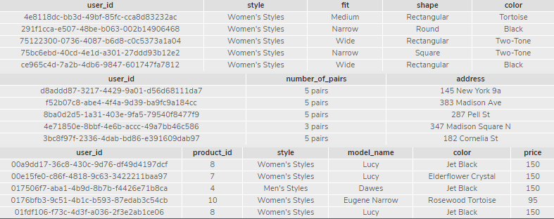
Home Try On Funnel
Warby Parker’s purchase funnel, the Home Try-On Funnel, is their customer journey toward purchase, beginning with the user taking the Style Quiz (quiz funnel).
The Home Try On Funnel is summarized by the following sequence of events:
The user takes the Style Quiz
The user proceeds to the Home Try On
The user makes a purchase
The tables and data collected from each include the following:
Quiz: | Home try on: | Purchase:
User id - the user identifier Style – style of frame Fit – width of frame Shape – shape of frame Color – color of frame | User id - the user identifier number_of_pairs – quantity of frames chosen Address – user’s address | User id - the user identifier product_id – product identifier Style – style of frame model_name – name of frame Color – color of frame Price – price of frame
SELECT *
FROM quiz
LIMIT 5;
SELECT *
FROM home_try_on
LIMIT 5;
SELECT *
FROM purchase
LIMIT 5;

Slide 11
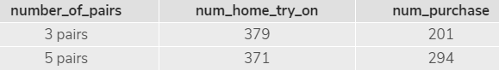
Home Try-On, A/B Test Results
Users are more likely to purchase when they get more pairs to try on.
The group that received 5 pairs to try on had a 79.24% conversion rate from home try on to purchase, compared to the 53.03% conversion rate of the group receiving 3 pairs.
Given that price is nearly the same across both groups, the difference could be that the group with 5 pairs has a greater selection to choose from and compare.
The conversion rate calculated in a separate Google Sheet as a percent change between the home try-on and purchase steps of the purchase funnel.
SELECT number_of_pairs, COUNT(DISTINCT home_try_on.user_id) AS 'num_home_try_on', COUNT(DISTINCT purchase.user_id) AS 'num_purchase'
FROM home_try_on
LEFT JOIN purchase
ON home_try_on.user_id = purchase.user_id
WHERE number_of_pairs = '3 pairs'
OR number_of_pairs = '5 pairs'
GROUP BY 1
ORDER BY 1 ASC;

Slide 12
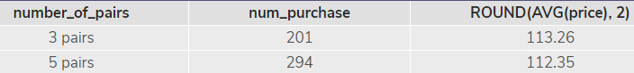
Home Try-On, A/B Test Results (continued from prev.)
Given that price is nearly the same across both groups, the difference could be that the group with 5 pairs has a greater selection to choose from and compare.
SELECT number_of_pairs, COUNT(DISTINCT purchase.user_id) AS 'num_purchase', ROUND(AVG(price), 2)
FROM home_try_on
LEFT JOIN purchase
ON home_try_on.user_id = purchase.user_id
GROUP BY 1
ORDER BY 1 ASC;

Slide 13
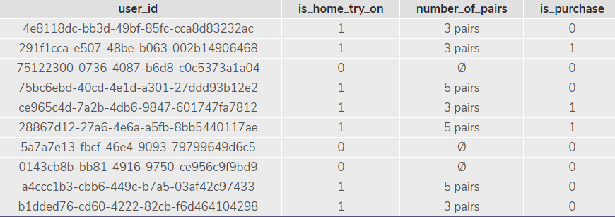
Home Try-On Funnel, Joining Tables
To analyze information across the user’s journey through Warby Parker’s purchase funnel, information from three tables (quiz, home_try_on, purchase) were combined using a LEFT JOIN. Columns were added to count the number of distinct users in the funnel for each stage.
SELECT DISTINCT q.user_id, h.user_id IS NOT NULL AS 'is_home_try_on', h.number_of_pairs, p.user_id IS NOT NULL AS 'is_purchase'
FROM quiz AS 'q'
LEFT JOIN home_try_on AS 'h'
ON q.user_id = h.user_id
LEFT JOIN purchase AS 'p'
ON h.user_id = p.user_id
LIMIT 10;

Slide 14
Home Try-On Funnel, Conversion Rates
Although conversion rates decline between each of the three steps in the purchase funnel, Completion rates between decline between each of the three steps, with the greatest decline
Conversion rate from quiz to home try-on is 75%
Conversion rate from home try-on to purchase is 66%
Created a funnel from multiple tables using a LEFT JOIN, and added columns to count the number of distinct users in the funnel for each stage.
Calculated percent change from each step of the funnel, from quiz to home try-on (quiz_to_hto) and home try-on to purchase (hto_to_purchase).
WITH funnel AS (
SELECT DISTINCT q.user_id, h.user_id IS NOT NULL AS 'is_home_try_on', h.number_of_pairs, p.user_id IS NOT NULL AS 'is_purchase'
FROM quiz AS 'q'
LEFT JOIN home_try_on AS 'h'
ON q.user_id = h.user_id
LEFT JOIN purchase AS 'p'
ON h.user_id = p.user_id)
SELECT COUNT(*) AS 'num_quiz', COUNT(
CASE
WHEN is_home_try_on = 1 THEN user_id
ELSE NULL
END) AS 'num_home_try_on', COUNT(
CASE
WHEN is_purchase = 1 THEN user_id ELSE NULL
END) AS 'num_purchase', 1.0 * SUM(is_home_try_on) / COUNT(*) AS 'quiz_to_hto', 1.0 * SUM(is_purchase) / SUM(is_home_try_on) AS 'hto_to_purchase'
FROM funnel;

Slide 15
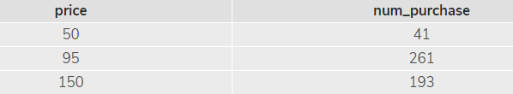
Home Try-On Funnel, Purchase by Price Point
We can tell that Warby Parker’s customers prefer frames in the middle pricing tier at $95 more than the lowest priced tier and the highest priced tier.
Combined data from the home_try_on and purchase tables with a LEFT JOIN to retrieve and added columns to count the number of distinct users in the funnel for each stage.
Calculated percent change from each step of the funnel, from quiz to home try-on (quiz_to_hto) and home try-on to purchase (hto_to_purchase).
SELECT price, COUNT(*) AS 'num_purchase'
FROM purchase
GROUP BY 1
ORDER BY 1 ASC;

Slide 16
4. Recommendations

Slide 17
Recommendations
Consider A/B testing on the style quiz with question 5. Recommendations include: removing it from the quiz, making this question optional, or adding an “I don’t know” option as a response.
Improve the style quiz completion rates.
Investigate what might be causing the user drop off between home try-on and purchase.
Give all users in the home try-on funnel 5 pairs to try on to improve likelihood of purchase.

